Slide 1


FYP
P
Intelligent Home Energy Management
For Power Consumption
Group Members
Taha Saeed (2133-2021)
M.Shoaib Azam (2172-2021
M.Khizer Mallick (2240-2021)
Supervisor
Dr. Umer Farooq
Co-Supervisor
Dr. Rashid Hussain
Department of Computing, FEST
Hamdard University

Slide 2
Summary
Problem Statement
Objective
FYP Scope
Our methodology
Our Project Plan (Time lines)
Budget / Costing (if any)
FYP Deliverables
References
Proposed GUI
P

Slide 3
Problem Statement
Homeowners want to save energy and reduce electricity bills but they facing challenges in managing and monitoring their electricity consumption in real-time. Using too much electricity bills which also strains the power grid.
Current system does not have the ability to alert homeowners before they exceed their desired limit of electricity units.
The goal is to develop a Real-Time Smart Home Energy Monitoring and Management System that measures energy consumption in units using different analysis method and alert the homeowner if they might exceed the given limit.
The system can also switch automatically to different energy sources such as rooftop solar system or generator so decrease electricity consumption from the grid.

Slide 4
Objective
1. To design energy management and monitoring system:
Develop a smart household electricity consumption monitoring system, aiming to enhance . efficiency and reduce costs of electricity bills through notifications and recommendations
2. Smart Energy management alerts:
Take control of energy consumption and save our bills by optimizing how we use electricity.It can suggest actions when consumption reaches 170 units it considers implementing energy-saving measures like turning off extra appliances. At 180 units, it starts preferring alternative energy sources like solar or generators to reduce the speed by which units consumed are increasing. And if we hit 190 units, it strongly advices user to limit their electricity use to keep the bill under budget.
3. Predictive energy Analytics:
Utilize an AI predictive algorithm to predict future consumption of electricity based on historical data, weather and solar generation.
4. User friendly interface:
Ensure a user-friendly interface which allows homeowners to customize their app according to their wants and needs. The interface will be made available for both android and IOS.

Slide 5
FYP Scope
The final year project will involve designing and developing a smart home energy management system. The system will aim to optimize energy usage within a household by integrating smart devices and sensors to monitor and control energy consumption. The project will include the development of a user-friendly interface for homeowners to track their energy usage, set preferences, and receive recommendations for energy-saving practices. The scope will encompass research, design, implementation, testing, and documentation of the smart home energy management system.

Slide 6
Our Methodology
Methodology:
The project will employ a hybrid methodology that blends Agile and Waterfall techniques. By ensuring a balanced development process, this method makes it easier to create intuitive user interface for monitoring energy consumption, customizing preferences, and getting energy saving advice.
Waterfall:
In order to lay a strong basis for the system, the first planning and design stages will employ an organized Waterfall methodology. This will include integrating smart devices and sensors for energy monitoring and control.
Agile:
Agile iterations will then be used for the project's implementation and testing phase, enabling flexibility, ongoing feedback, and change adaption.

Slide 7
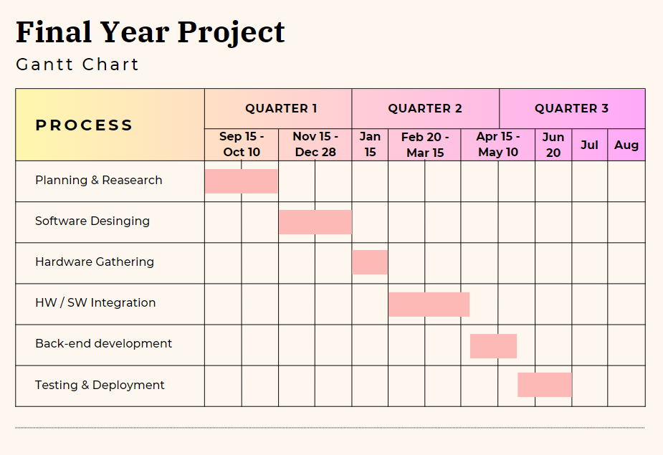
Our Project Plan

Slide 8
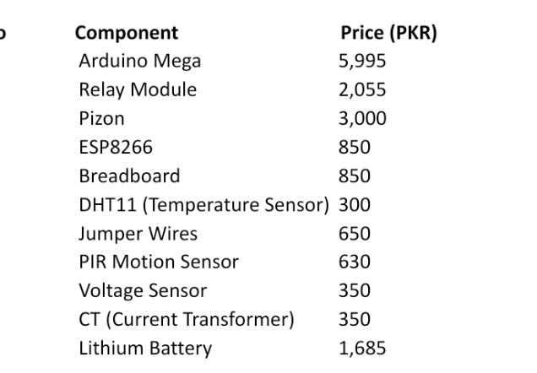
Budget / Costing

Slide 9
FYP Deliverables
UI Design
Proposed System
User Manual
Source Code CD/Usb
Project Report – II (complete)
Back End
Working prototype

Slide 10
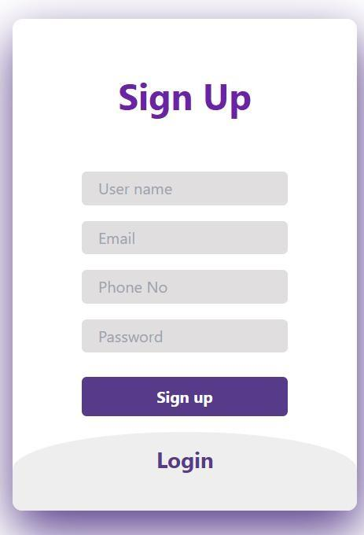
Proposed GUI

Slide 11
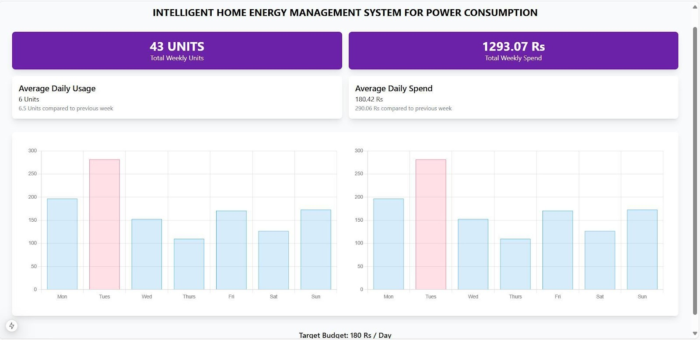
Proposed GUI

Slide 12
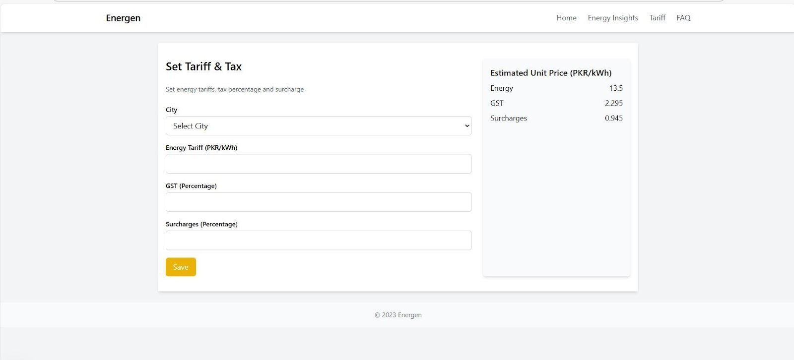
Proposed GUI

Slide 13
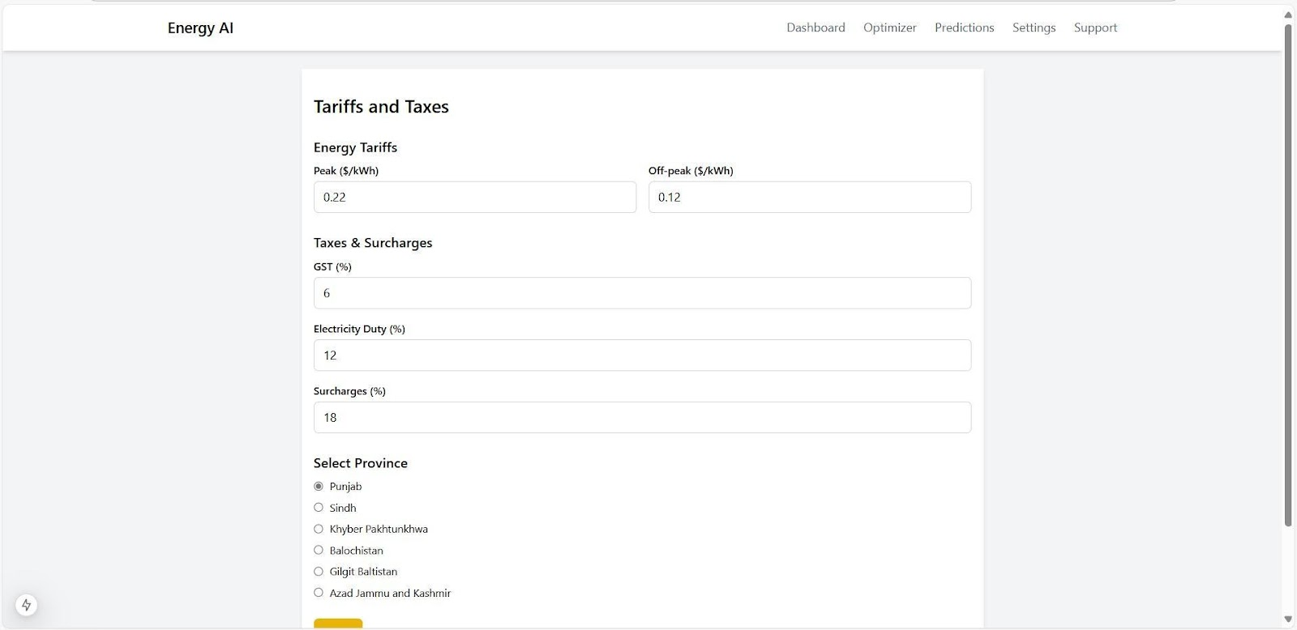
Proposed GUI

Slide 14
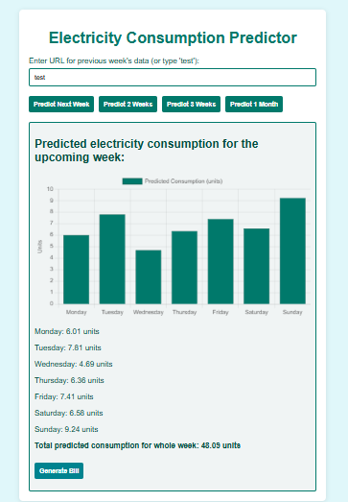
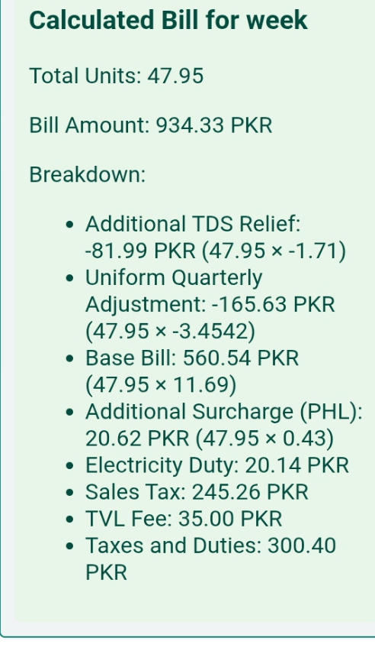
Proposed GUI

Slide 15
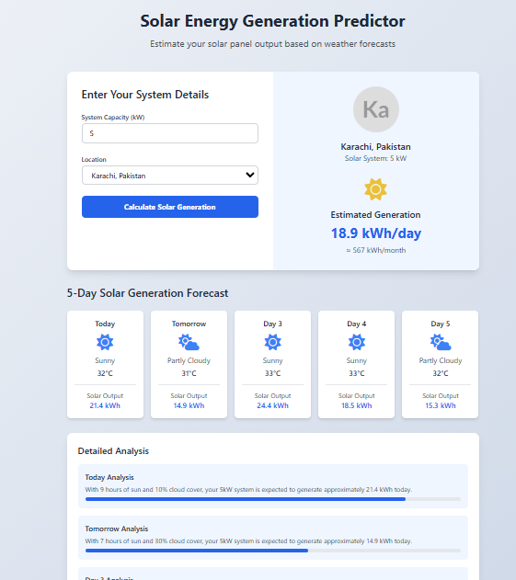
Proposed GUI

Slide 16
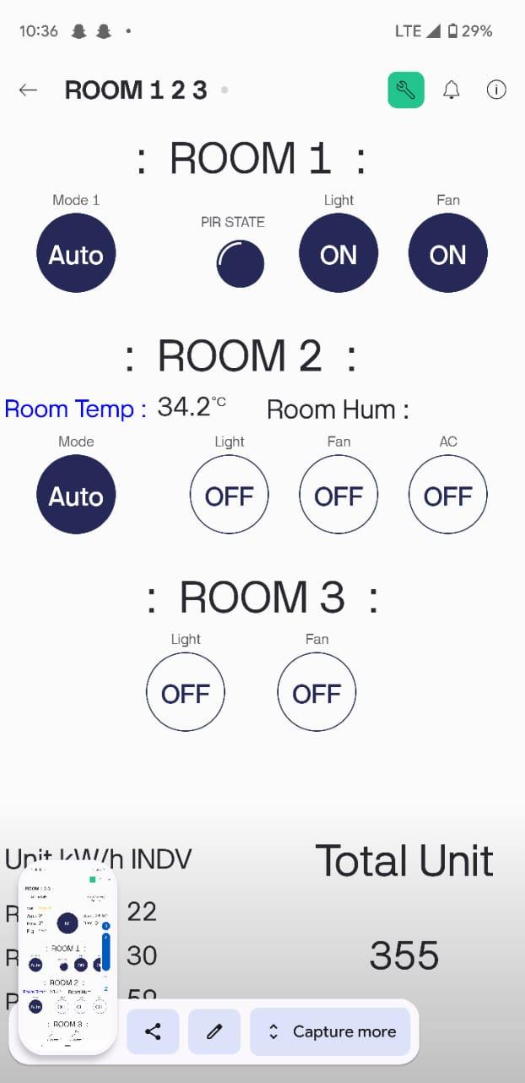
Proposed GUI
.

Slide 17
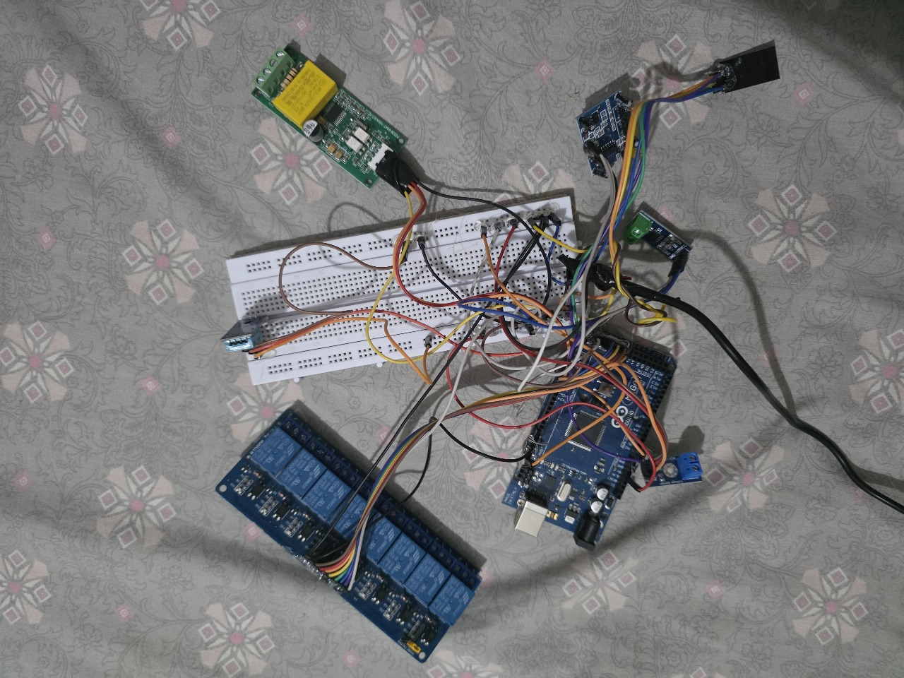
Prototype picture
.

Slide 18
Reference
[Design and implementation of a Smart Home Energy Management System With Integrated Green Energy Monitoring considering energy saving
ALiero MS, Qureshi KN, Pasha MF, Jeon G (2021) Smart home energy management systems in Internet of things networks for green cities demands and services. Environ Technol Innov 20:101443
Mahmoud H Elkholy, Tomonobu Senjyu, Mohammed Elsayed Lotfy, Abdelrahman Elgarhy, Nehad S Ali, Tamer S GaafarSustainability 14 (21), 13840, 2022
A smart home energy management system using IoT and big data analytics approach
Abdul-Rahman Al-Ali, Imran A Zualkernan, Mohammed Rashid, Ragini Gupta, Mazin AliKarar IEEE Transactions on Consumer Electronics 63 (4), 426-434, 2017

Slide 19
Reference
Smart home energy management systems: Research challenges and survey
Ali Raza, Li Jingzhao, Yazeed Ghadi, Muhammad Adnan, Mansoor AliAlexandria Engineering Journal 92, 117-170, 2024
Smart Energy Management System Using Machine Learning
Ali Akram, Sagheer Abbas, Muhammad Khan, Atifa Athar, Taher Ghazal, Hussam Al Hamadi Computers, Materials & Continua 78 (1), 2024
A smart home energy management approach incorporating an enhanced northern goshawk optimizer to enhance user comfort, minimize costs, and promote efficient energy consumption
Heba Youssef, Salah Kamel, Mohamed H Hassan, Juan Yu, Murodbek SafaralievInternational Journal of Hydrogen Energy 49, 644-658, 2024

Slide 20
THANK YOU!

